Slide 1
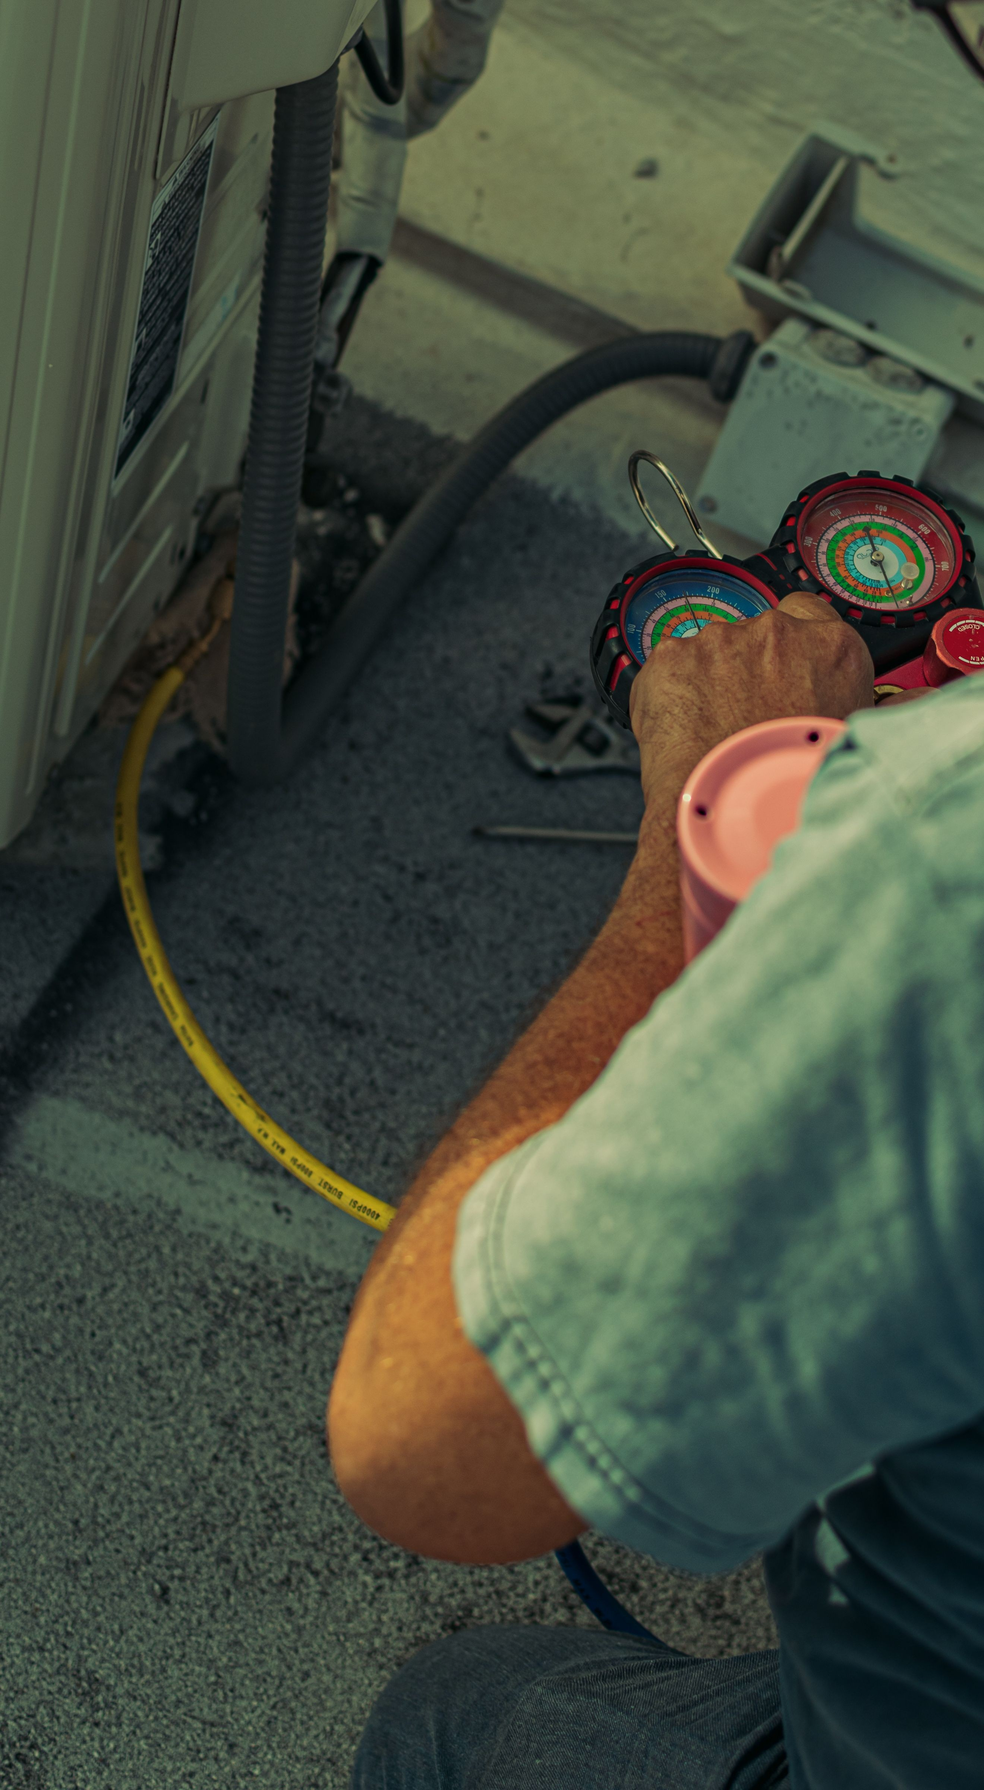
FIELD DIAGNOSTICS REVIEW
Commercial and residential service week summary
Prepared by Joseph William Fields
Senior HVAC Technician, Central Ohio Climate Solutions LLC
Period: February 16 to 20, 2026
Field Diagnostics Review
Private and personal

Slide 2
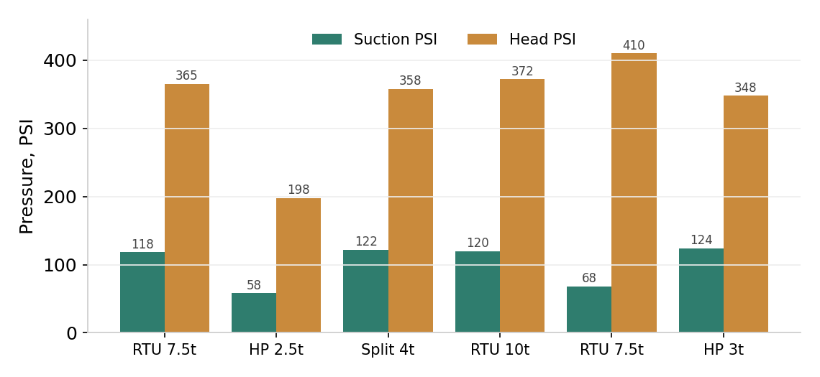
Service Week At A Glance
10
9 of 10
6
0
Calls completed
First time fix
System types
Callbacks
Pressure readings by unit
Notes
R410A unless noted.
Readings logged on site for warranty and callback reference.
Routing planned to keep Wednesday custody pickups on time.
Field Diagnostics Review
Private and personal

Slide 3
Diagnostic Readings
Unit | Suction PSI | Head PSI | Superheat | Subcool | Diagnosis
7.5 ton rooftop | 118 | 365 | 14 | 9 | Weak capacitor, restored after replace
2.5 ton heat pump | 58 | 198 | 22 | 3 | Low charge plus stuck reversing valve
4 ton split | 122 | 358 | 12 | 10 | Pitted contactor, no start
10 ton rooftop | 120 | 372 | 13 | 8 | Loose low voltage, intermittent
7.5 ton rooftop | 68 | 410 | 3 | 16 | Frozen coil, low airflow, duct
3 ton heat pump | 124 | 348 | 12 | 9 | Worn fan bearing, replaced
All readings captured during the February 16 to 20 service week.
Field Diagnostics Review
Private and personal

Slide 4
Work Orders Completed
WO | Site | City | Issue | Hours
58841 | Riverbend Office Plaza | Dublin | No cooling, second floor | 2.5
58850 | Maple Ridge Apartments | Hilliard | Weak heat, high bills | 3.0
58851 | Grandview Cafe | Grandview Heights | Compressor not starting | 1.0
58863 | Westerville Dental Group | Westerville | Intermittent cooling | 1.5
58875 | Library annex | Upper Arlington | Frozen evaporator | 2.5
58890 | Private residence | Upper Arlington | Loud outdoor unit | 1.5
Coverage across metro Columbus. Total billable hours 12.0 across ten calls, first time fix on nine.
Field Diagnostics Review
Private and personal

